Slide 1
INSTRUCTIONS: Please use this template for your presentation.
The slides labeled REQUIRED are necessary to ensure that ASPEN remains in compliance with various accrediting bodies. All other slides are for samples or informational purposes.
The ASPEN logo should be included on your slides.
There should be no use of brand names, product logos, or product images in your presentation.
The yellow boxes on slides contain instructional text only. Please review this information before completing your presentation.
Please delete the yellow boxes with instructional text and any unused template slides before submitting your final presentation!
***Delete this slide when done.***

Slide 2
Section Title Slide with Speaker Photo
Presentation Title Slide – With Photo
To insert photo within picture box, 1) click on the box, 2) select the appropriate photo from your computer, 3) click on Insert.
If photo is cropped and does not fit within picture box, do the following:
After inserting photo, you should see the Picture Format menu on the top right screen. Underneath this menu, select the downward facing arrow under Crop on the far-right side of screen.
Scroll down to bottom of menu and click on Fill, then use your mouse to move the photo so that it fits within the box.
***Delete instruction boxes when done.***
Name, Credentials
Title
Department
Place of work
City, state
Notes:
Read the slide

Slide 3
Section Title Slide Without
Speaker Photo
Presentation Title Slide – No Photo
If you are not including your photo, use this slide for your presentation title page.
***Delete instruction boxes when done.***
Name, Credentials
Title, Department, Place of work
City, state
Notes:
Read the slide

Slide 4
Disclosure
Disclosures Slide - Required
In order to comply with accreditation guidelines, ALL disclosures/relationships with ineligible companies within the past 24 months must be included.
Enter Name of Company and Affiliation. If you do not have any disclosures, enter “No commercial relationships to disclose.”
***Delete instruction boxes when done.***
Notes:
Read the Slide

Slide 5
Learning Objectives
Learning Objectives Slide - Required
Please add at least 3 objectives for your presentation.
For assistance with writing learning objectives, right click on Model of Learning Objectives and then select Open Link.
***Delete instruction boxes when done.***
Upon completion of this educational activity, the learner will be able to:
Objective one
Objective two
Objective three

Slide 6
Sample Slide With Callout Box
Product/Brand Usage instructions:
  You must use generic names and not product/brand/company names in your presentation content and images.
  If it is mandatory that you use a product name, please discuss this with staff.
***Delete instruction boxes when done.***
20% of patients with cancer die from malnutrition and not from their underlying disease!
Reference Instructions:
References should be listed at the bottom of the slide and included in the final references slide at the end of this deck.
If the same reference is used on consecutive slides, it should be repeated at the bottom of each slide.
All images must be cited, even if they are screen grabs/taken from the internet.
Please follow the AMA style, abbreviating names of journals according to Index Medicus.
***Delete instruction boxes when done.***

Slide 7
Sample Text Slide
Product/Brand Usage instructions:
  You must use generic names and not product/brand/company names in your presentation content and images.
  If it is mandatory that you use a product name, please discuss this with staff.
***Delete instruction boxes when done.***
Bullet point one
  Sub bullet point
Bullet point two
  Sub bullet point
  Sub bullet point
Bullet point three
  Sub bullet point
Reference Instructions:
References should be listed at the bottom of the slide and included in the final references slide at the end of this deck.
If the same reference is used on consecutive slides, it should be repeated at the bottom of each slide.
All images must be cited, even if they are screen grabs/taken from the internet.
Please follow the AMA style, abbreviating names of journals according to Index Medicus.
***Delete instruction boxes when done.***
Please put references on the bottom of the slide and compile them into the final references slide.
Follow the AMA style, abbreviating names of journals according to Index Medicus.

Slide 8
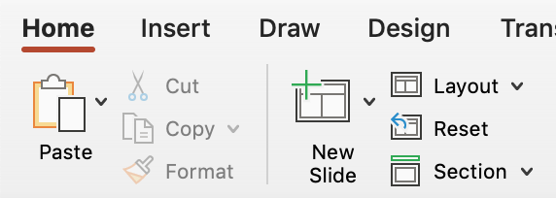
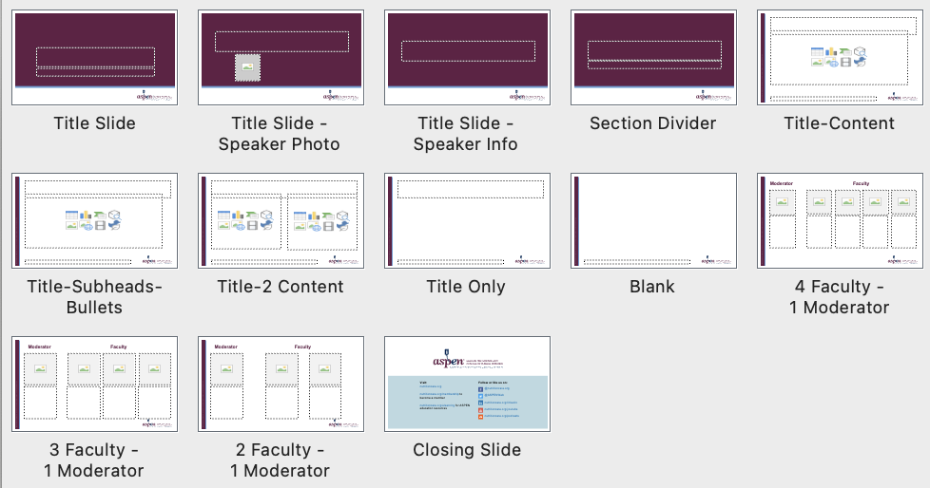
Slide Layouts
This slide shows you how to change the layout for a slide.
Note: Animations will not show on the webinar platform, but you can mimic animation by using multiple slides and placing each change on a new slide.
***Delete instruction boxes when done.***
How to access layouts
All layouts are labeled and available in the layout panel of the toolbar
How to use layouts to format
Option 1: “New Slide” in the toolbar will add a new slide and assign it the previously selected layout. To update the layout, go to the layout panel and choose another option.
Option 2: “Copy & Paste” any slide in this template and customize as needed.

Slide 9

Case Study Template - Female
This and other slides show other ways of including content in your presentation. i.e. case studies, charts, graphs, tables, etc.
This information is not required but can be visually stimulating for the audience. This is considered the descriptive part of the presentation and may be several slides in length.
***Delete instruction boxes when done.***
Was trialed on a Gastrostomy-Jejunostomy and tube feedings along with Parenteral Nutrition (PN) in the past (developed cholestatic liver disease).
Never gained weight on tube feeds. Weight went from 190 to as low as 76 pounds.
Patient was getting by, just eating orally and maintaining weight around 103 pounds, until February of 2020.
Product/Brand Usage instructions:
  You must use generic names and not product/brand/company names in your presentation content and images.
  If it is mandatory that you use a product name, please discuss this with staff.
***Delete instruction boxes when done.***

Slide 10

Case Study Template – Male
This and other slides show other ways of including content in your presentation. i.e. case studies, charts, graphs, tables, etc.
This information is not required but can be visually stimulating for the audience. This is considered the descriptive part of the presentation and may be several slides in length.
***Delete instruction boxes when done.***
HPI:
Profuse diarrhea + abdominal pain
Current medications: cyclosporine, prednisolone
Findings:
  ↑ cyclosporine level
  labs consistent with AKI and dehydration
PMH:
Diffuse anaplastic Wilms Tumor w/ pulmonary metastatic disease
Treatment-related Myelodysplastic Syndrome
  Day +55 s/p HSCT
Post-HSCT course notable for GI GVHD
Product/Brand Usage instructions:
  You must use generic names and not product/brand/company names in your presentation content and images.
  If it is mandatory that you use a product name, please discuss this with staff.
***Delete instruction boxes when done.***

Slide 11
Sample Diagram
Product/Brand Usage instructions:
  You must use generic names and not product/brand/company names in your presentation content and images.
  If it is mandatory that you use a product name, please discuss this with staff.
***Delete instruction boxes when done.***
xx
x
xx
xx
Reference Instructions:
References should be listed at the bottom of the slide and included in the final references slide at the end of this deck.
If the same reference is used on consecutive slides, it should be repeated at the bottom of each slide.
All images must be cited, even if they are screen grabs/taken from the internet.
Please follow the AMA style, abbreviating names of journals according to Index Medicus.
***Delete instruction boxes when done.***

Slide 12
Table Sample 1
Product/Brand Usage instructions:
  You must use generic names and not product/brand/company names in your presentation content and images.
  If it is mandatory that you use a product name, please discuss this with staff.
***Delete instruction boxes when done.***
xx | xx | xx
Intact protein is more trophic | Long-chain triglycerides stimulate adaptation | Disaccharides may be poorly absorbed due to loss of brush border enzymes
Amino-acid based reduces risk of secondary protein intolerance | Medium-chain triglycerides may be better absorbed (independent of bile salts) | Soluble fiber promotes adaptation and can be added when colon is present
Reference Instructions:
References should be listed at the bottom of the slide and included in the final references slide at the end of this deck.
If the same reference is used on consecutive slides, it should be repeated at the bottom of each slide.
All images must be cited, even if they are screen grabs/taken from the internet.
Please follow the AMA style, abbreviating names of journals according to Index Medicus.
***Delete instruction boxes when done.***

Slide 13
Table Sample 2
Product/Brand Usage instructions:
  You must use generic names and not product/brand/company names in your presentation content and images.
  If it is mandatory that you use a product name, please discuss this with staff.
***Delete instruction boxes when done.***
xx | xx | xx
High losses after bowel resection, along with Mg + Se Deficiency can present with dermatitis Co-factor for ALP synthesis so ALP levels are low in deficiency | Both have been implicated in IFALD Copper deficiency = pancytopenia Monitor levels | Consider deficiency for patients receiving mostly parenteral nutrition Can usually be replaced enterally due to absorption in the duodenum
xx | xx
In preterms check 25-OH-D after 2 weeks on PN In infants and children check levels every 3-4 months | Patients who have lost significant ileum at high risk for deficiency Monitor levels every 4-6 months
Reference Instructions:
References should be listed at the bottom of the slide and included in the final references slide at the end of this deck.
If the same reference is used on consecutive slides, it should be repeated at the bottom of each slide.
All images must be cited, even if they are screen grabs/taken from the internet.
Please follow the AMA style, abbreviating names of journals according to Index Medicus.
***Delete instruction boxes when done.***

Slide 14
Table Sample 3
Product/Brand Usage instructions:
  You must use generic names and not product/brand/company names in your presentation content and images.
  If it is mandatory that you use a product name, please discuss this with staff.
***Delete instruction boxes when done.***
XXX | XXX | XX | XX | XX | XX
06/09/2020 | 134 L | 3.4 L | 8.6 | 4.1 | 2.3
06/10/2020 | 136 | 3.3L | 7.8 L | 3.3 L | 2.6
06/11/2020 | 138 | 4.2 | 8.1 L | 3.1 L | 2.6
06/13/2020 | 136 | 4.4 | 8.9 | 3.8 | 3.8 H
Reference Instructions:
References should be listed at the bottom of the slide and included in the final references slide at the end of this deck.
If the same reference is used on consecutive slides, it should be repeated at the bottom of each slide.
All images must be cited, even if they are screen grabs/taken from the internet.
Please follow the AMA style, abbreviating names of journals according to Index Medicus.
***Delete instruction boxes when done.***

Slide 15
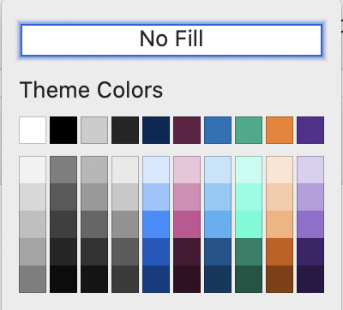
Color Palette
This slide shows ASPEN’s color palette.
***Delete instruction boxes when done.***
Theme Colors – primary brand colors built into template
Secondary Colors
FC4C02
FDB831
679FD5
59C2AD
FFCF85
8363AA
F9A458
F1C586
BAD9E1
BEE3DC
FFE4B8
DDC8DE

Slide 16














Icons
You may use the icons below for ASPEN webinars.
To change the color of an icon, double-click on the icon and choose a new color from the ASPEN palette on the previous slide.
***Delete instruction boxes when done.***
To change the color, double-click on an icon and choose a new color from the ASPEN palette on the previous slide.

Slide 17
Section Divider Slide
Section Divider Slide
Use this slide to separate different topics or sections in your presentation.
***Delete instruction boxes when done.***

Slide 18
Learning Assessment Question 1
Learning Assessment Question Slide(s) - Required
Include three to five (3 to 5) learning assessment questions in your presentation. You can use the same questions from your outline.
Questions should contain at least four answer choices. Answers choices should not include “all of the above,” “none of the above,” or “true/false.”
These questions can be used as polling questions. Please notify ASPEN staff if you plan to utilize polling questions.
***Delete instruction boxes when done.***
Multiple choice question 1?
Option 1
Option 2
Option 3
Option 4

Slide 19
Learning Assessment Answer 1
Learning Assessment Answer Slide(s) - Required
Correct answer in bold/orange #F57F26. Change letter to orange in the bullets/numbering dropdown.
***Delete instruction boxes when done.***
Multiple choice question 1?
Option 1
Option 2
Option 3
Option 4

Slide 20
References List
References Slide(s) – Required
List references used in your presentation on this slide.
Follow the AMA style, abbreviating names of journals according to Index Medicus.
For 1-6 authors, list each author. For 7 or more authors, list the first 6 authors, followed by et al.
***Delete instruction boxes when done.***
Numbered text. Current references to support your overall presentation
Cole BR. Cystinosis and cystinuria. In: Jacobson HR, Striker GE, Klahr S, eds. The Principles and Practice of Nephrology. Philadelphia, PA: BC Decker Inc; 1991:396–403.
Davis JT, Allen HD, Powers JD, Cohen DM. Population requirements for capitation planning in pediatric cardiac surgery. Arch Pediatr Adolesc Med. 1996;150:257–259.

